Slide 1
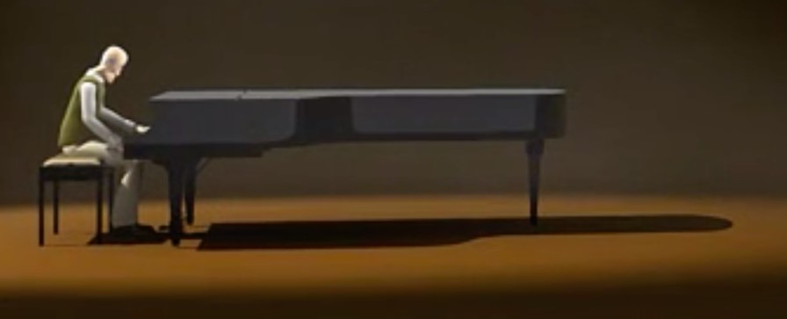
Sentences and their Punctuation
What is a sentence?
How are sentences punctuated?
Do you know the different parts of a sentence or clause?

Slide 2
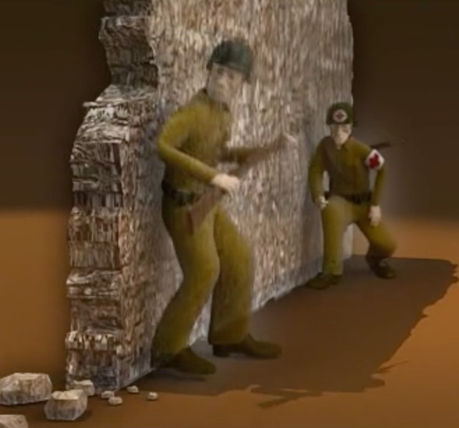
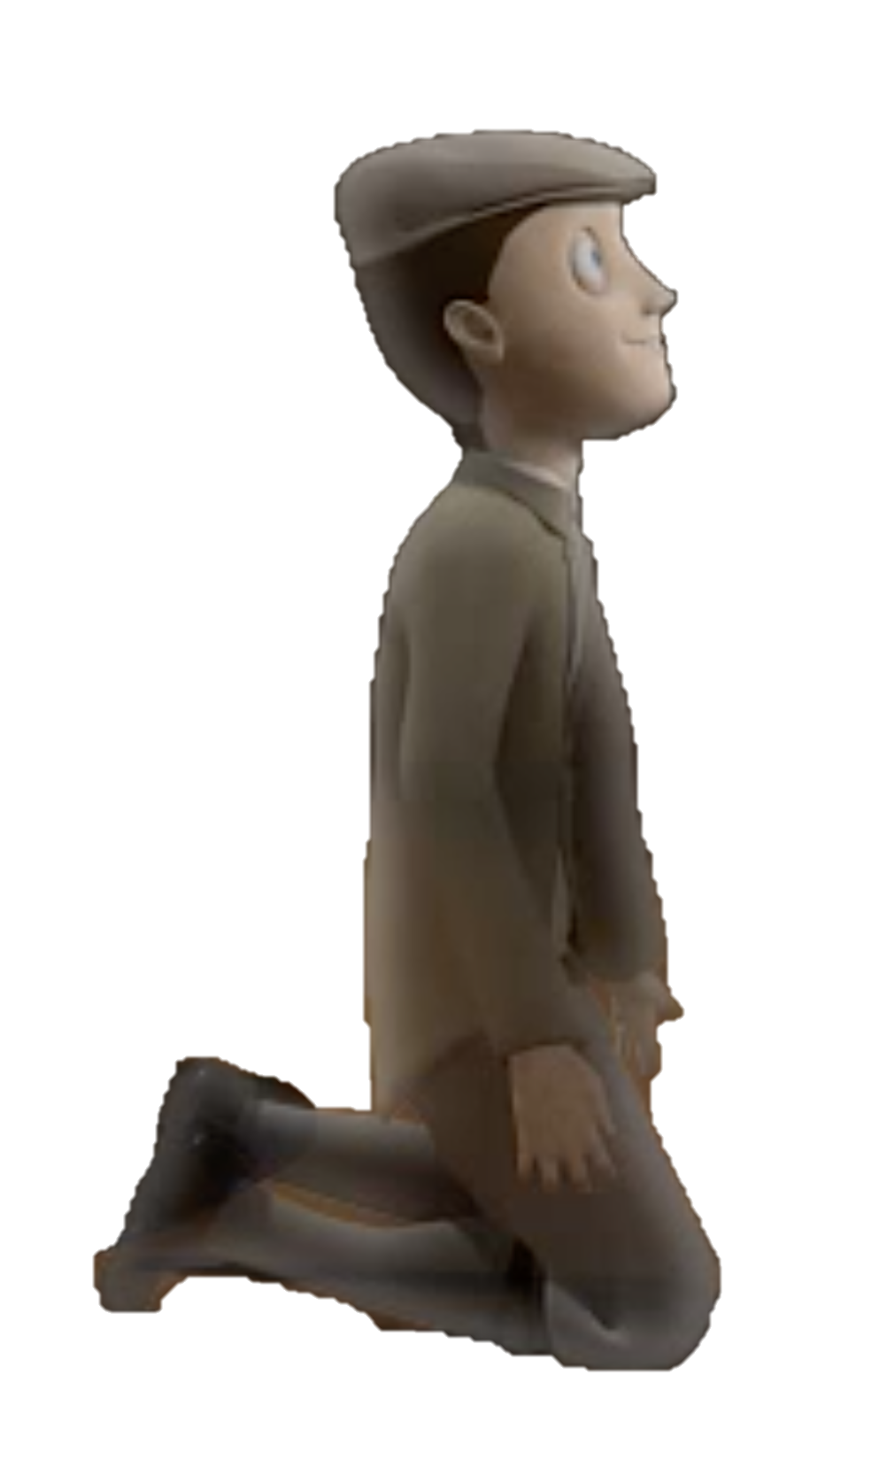
Sentences
They went to battle.
The man led the way.
His friend is alongside him.
His worst fears became reality.
Was it his fault?
Sentences make sense by themselves.
They need at least one main clause.
Each clause has an active verb.
Can you spot the active verb in each sentence?

Slide 3
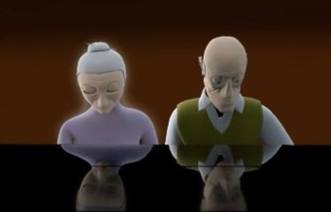
Sentences
Which of these are complete sentences?
ANSWERS
a smile
a smile was shared
they played the piano together
she gazed
before I knew what was happening
A complete sentence needs an active verb and something or someone doing that verb.
This is a subordinate clause. It has a subordinating conjunction at its head and does not contain a complete idea.

Slide 4
Sentences and their Punctuation
ANSWERS
We punctuate sentences to make our writing clearer.
A capital letter goes at the beginning and the end is indicated by…
a full stop, question mark or exclamation mark.
he was playing
sweetheart, now
what could he do
that was a surprise
smiled quietly
Punctuation does not make a complete sentence; it makes the beginning and ending clear.
H
.
not a complete sentence
- no verb.
W
?
not a complete sentence – who is doing the verb?
How would you punctuate these?
T
!

Slide 5
Parts of a Clause
A clause is a group of words which contains a verb.
The verbs have a subject.
This clause is about the man.
The subject is what the clause is about.
The man remembered
The child played
Memories grew
This clause is about the child.
This clause is about memories.
In some clauses there is something the verb acts on.
This is called the object.

Slide 6
subject verb object
Parts of a Clause
A clause is a group of words which contains a verb.
All verbs have a subject.
The subject is what the clause is about.
The man remembered
The child played
Memories grew
his life
the piano
The object is affected by the verb.
in his mind
In some clauses there is something the verb acts on.
This is called the object.

Slide 7
subject verb object
Parts of a Clause
ANSWERS
I remembered the whole thing.
He opened his eyes.
His fingers touched the keyboard.
The boy opened the mysterious box.
His wife smiled.
Can you spot the subject, verb and object in each of these clauses?
The whole noun phrase can be counted as the object
‘the living room’, ‘a grand piano’ etc.
some clauses do not have an object

Slide 8
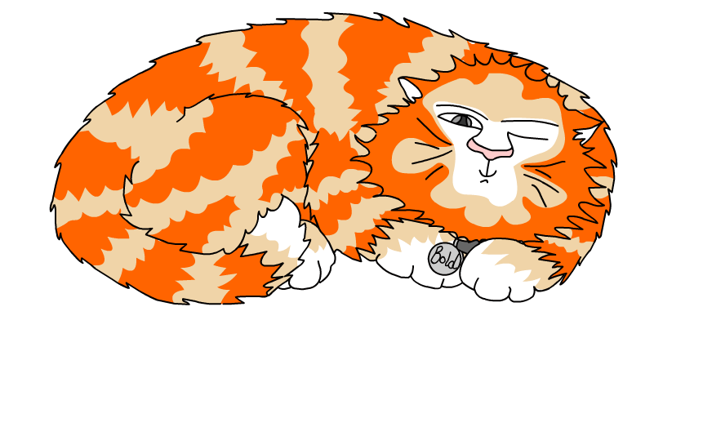
Explore more Hamilton Trust Learning Materials at https://wrht.org.uk/hamilton/ .

