Slide 1
Clauses and Conjunctions
since
until
while

Slide 2
What do we remember about clauses?
Clauses are groups of words with an active verb; they make sense.
These are all clauses because they have an active verb and they make sense.
She looked around.
Lizzie was in darkness.
She could see nothing.
They are called single-clause sentences because one clause makes up the entire sentence.
They can stand alone so they are main clauses (also called independent clauses).

Slide 3
Independent clauses can be linked by and, or, but.
She looked around but she could see nothing.
Lizzie was in darkness and she could see nothing.
She looked around but she could see nothing.
Lizzie was in darkness and she could see nothing.
They are called multi-clause sentences because the sentence is made up of more than one clause.
The conjunctions
and, or and but
are
co-ordinating conjunctions.
They link independent clauses with equal importance to the meaning of the sentence.

Slide 4
Some sentences are made up of more than one clause.
Choose two independent clauses to link using and, or, but.
Seals love fish. | They can get quite plump at certain times of the year.
Seals enjoy playing in the icy sea. | They tend to huddle together in the cold.
Penguins are very clever. | They form a solid circle with their backs to the cold.
Penguin parents can take turns to keep the egg warm. | They can decide that one of them catches the fish.
Ideas
Seals love fish and they can get quite plump at certain times of the year.
Seals enjoy playing in the icy sea but they tend to huddle together in the cold.
Penguins are very clever and they form a solid circle with their backs to the cold.
Penguin parents can take turns to keep the egg warm or they can decide that one of them catches the fish.

Slide 5
Subordinating Conjunctions
Some conjunctions add extra information to an independent clause.
Conjunctions can give meaning to the links, to do with…
time
place
cause
condition
contrast
when
while
since
as
before
after
until
where
wherever
because
as
since
if
unless
even if
although
though
whereas
while

Slide 6
Subordinating conjunctions link
main clauses to subordinate clauses.
Lizzie was in darkness although she could sense that someone else was there.
She could see nothing even if she opened her eyes wide.
When she heard a sound, she looked around nervously.
These are still called multi-clause sentences because the sentence is made up of more than one clause.
These sentences are made up of a main clause (which carries the most important information) and…
…a subordinate clause which adds to the meaning of the main clause but cannot stand alone.

Slide 7
Which is the main clause and subordinate clause
in each of these multi-clause sentences?
Without getting out of her sleeping bag, she could see the seals.
They still looked pretty sleepy, although it was hard to tell.
While lying there thinking of not much, she heard the sound of a helicopter.
When she was sure what it was, Lizzie got out of her sleeping bag.
She wanted to be up when the helicopter landed.
Before the noise had died down, she was outside and running toward it.
ANSWER

Slide 8
Which is the main clause and subordinate clause
in each of these multi-clause sentences?
Without getting out of her sleeping bag, she could see the seals.
They still looked pretty sleepy although it was hard to tell.
While lying there thinking of not much, she heard the sound of a helicopter.
When she was sure what it was, Lizzie got out of her sleeping bag.
She wanted to be up when the helicopter landed.
Before the noise had died down, she was up and running toward it.
ANSWER

Slide 9
Why might we use multi-clause sentences?
Extending and linking clauses with conjunctions helps us to:
add extra detail to a sentence
play with sentence length for impact
vary the rhythm of our writing to help it flow

Slide 10
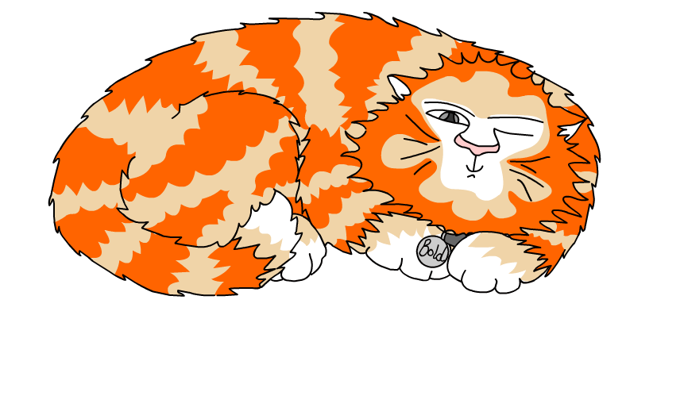
Explore more Hamilton Trust Learning Materials at https://wrht.org.uk/hamilton/ .

