Slide 1


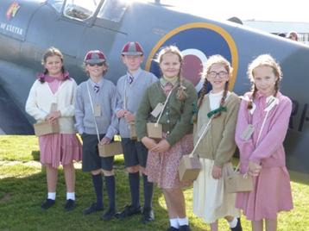


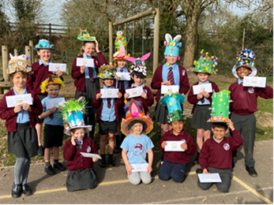
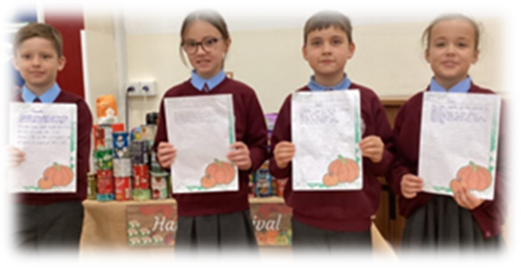
Welcome to...
The March CE
Primary School
"Education is not the filling of a pail,
but the lighting of a fire"
WB Yeats
13th November 2025

Slide 2

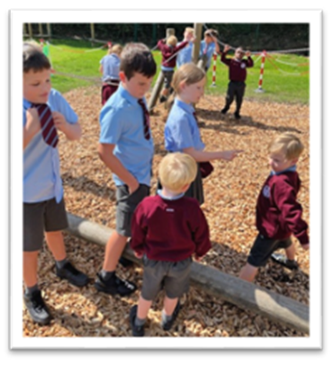
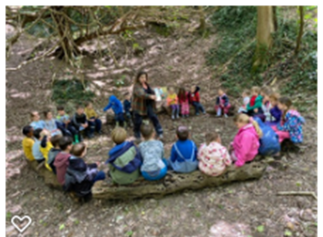
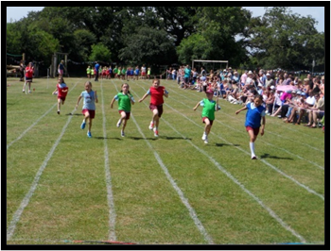
Welcome to our open day!
Introduction to The March CE Primary School
Visit the classrooms with Ambassadors
"The important thing is not to stop
questioning."
Albert Einstein

Slide 3
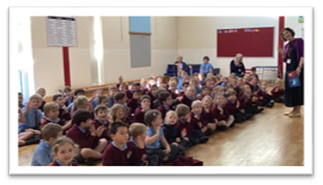
Who We Are
DCat family
A friendly professional approach to learning
An open-door policy: meet SLT every morning on school gate
A Partnership
Knowing children as individuals=Relationships
Strong Christian Values Love Faith, Forgiveness, Peace and Compassion
With God's help we will live kindly, love each other, learn and laugh together”

Slide 4
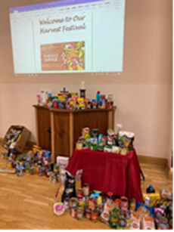
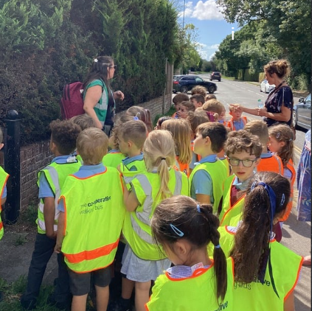
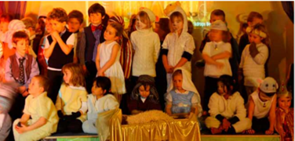
Community
Small friendly community increasing in size
PTA
Governors
link to St. Peters and St Andrews
RR and Goodwood
Dovecote
Chichester/Goodwood schools
Big Sing/Chichester Festival Theatre
Useful contacts: Miss Jones Miss Burch

Slide 5

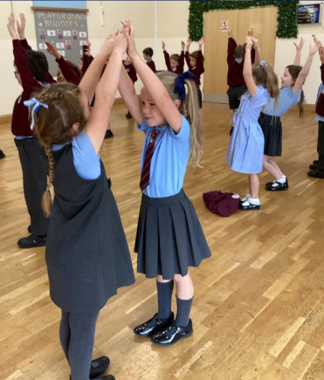
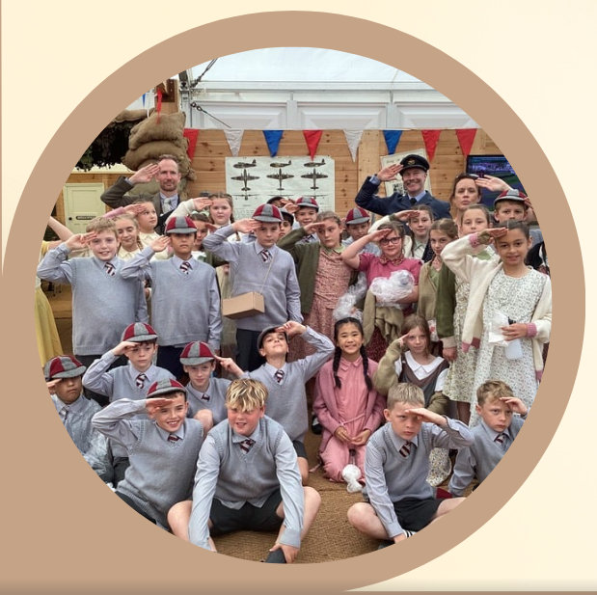
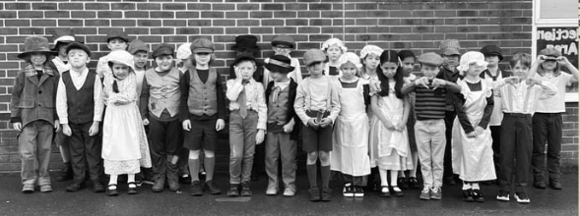
Curriculum
Our curriculum framework places high value on excellent school practice and research evidence to inform our curriculum principles .
These principles emphasise the importance of our curriculum design, sequencing of knowledge and progression across the year groups.
•Enrichment
•Topic every 6 weeks
•Education Visits
•Book Looks for parental involvement
•Designed to engage all learners

Slide 6
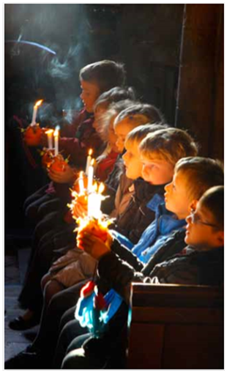
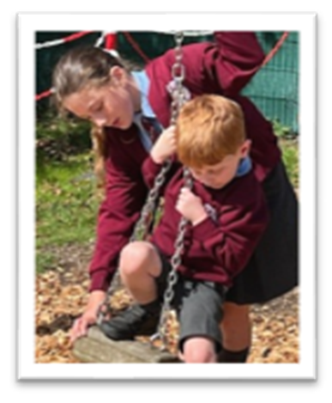
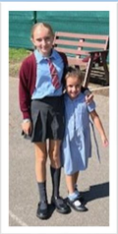
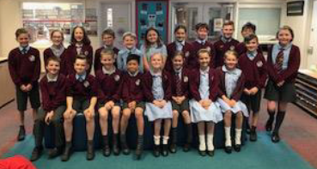

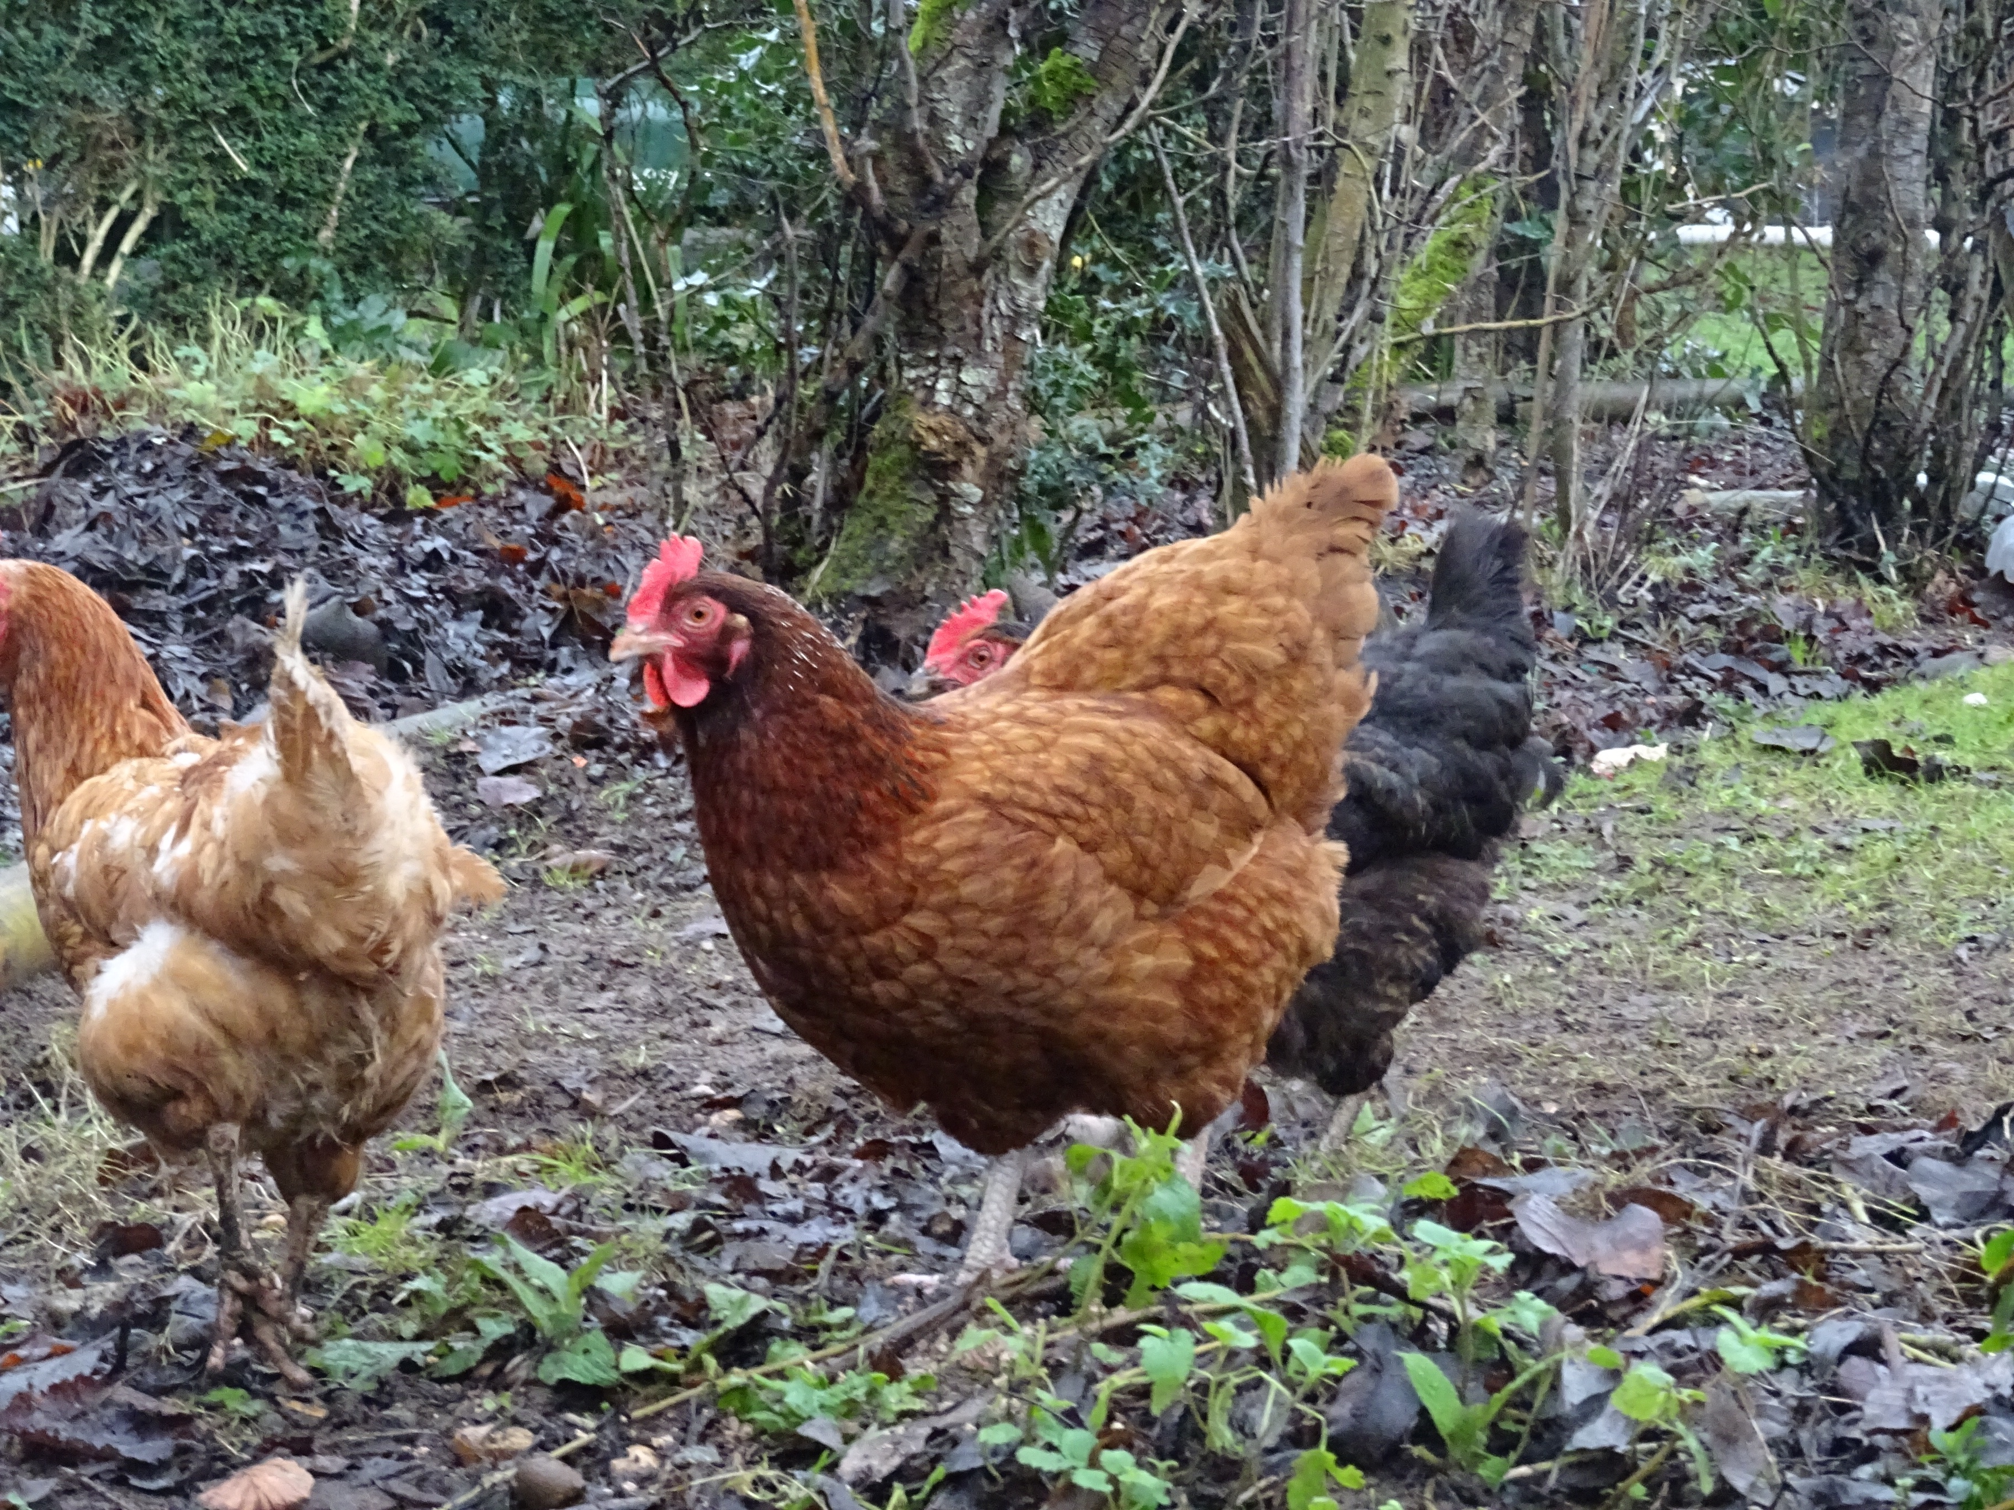
The March Family
•Buddies
•House System
•Worship
•Playtimes and Lunchtimes
•Wellbeing-tHRIVE sCHOOL

Slide 7



Proud to be...
Responsibilities- Ambassadors
Faith Council, Play Leaders, House Captains, School Cuncil
Class Dojos
Certificates including Excellence Award and Head Teachers award
Badges and Head Teacher stickers
Newsletter + Floorbooks

Slide 8
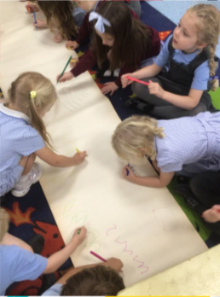
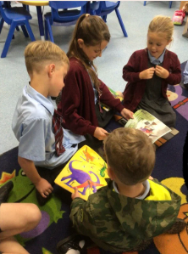
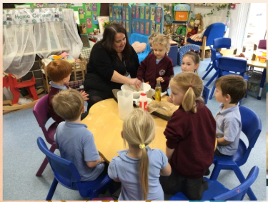
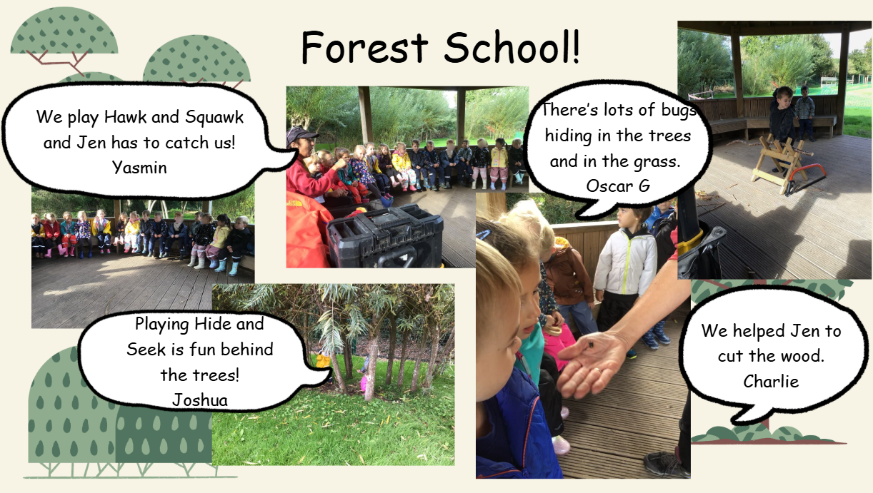
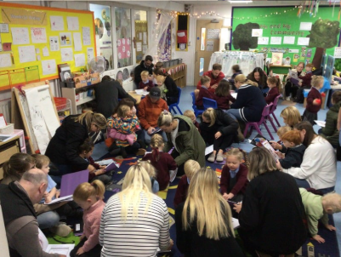
Early Years
•Flying Start
•Forest school
•Continuous provision
•Buddies
•Parent Partnership
•EYFS Team

Slide 9
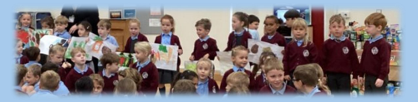
We are proud of...
Our Children and staff!
Being a church school and part of DCAT
OFsted in March 2023
“good with outstanding personal Development””
Our results year on YeAr above national
Enrichment opportunities for all!

